Slide 1




Faizan Ali
Teaching Assistant | Data Scientist |
Software Engineer
faizan.ali.itech

Slide 2
Who this course is for?

Slide 3

Who this course is for?
If you can answer “YES” to the below questions
Are you new to the Programming?
Do you want to make cool projects?
Are you a Intermediate Programmer who wants to solve problems using Data Science tools

Slide 4
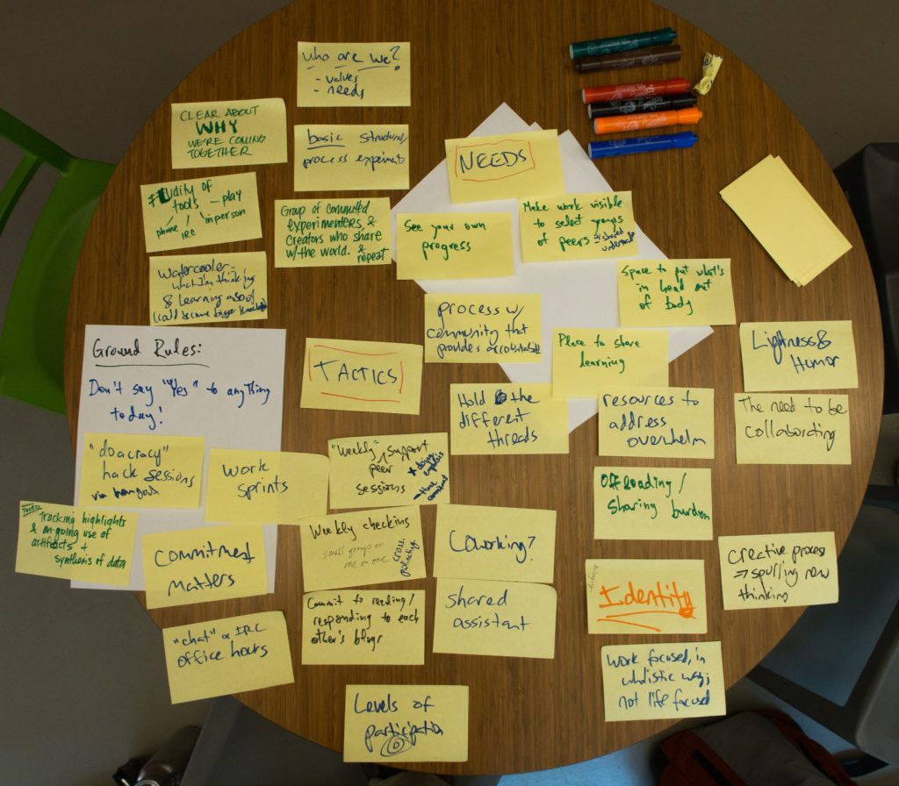
Learning & Takeaways
Become a better Python Programmer.
Write Neat and Structured Code.
Learn Data Science Fundamentals
Be able to tackle Data Science Case Studies
Create Plenty of New Projects

